Slide 1
Mini Project Semester IV
Theory / Tutorial - 2

Slide 2
Project Development
Program/ Product: Software code, End services or something tangible
People: Developer, Clients and End Users
Process: Hardware, product building, assembly, development of software
Project: People + Process + Product

Slide 3
Project
“A project is a temporary endeavor undertaken to create a unique product or a service”
Projects are often implemented as a means of achieving an organization’s strategic plan
May involve a single person or thousands of people
Duration may range from a few weeks to few years
May involve a single unit in the organization or may cross organizational boundaries, as in a joint ventures and partnering

Slide 4
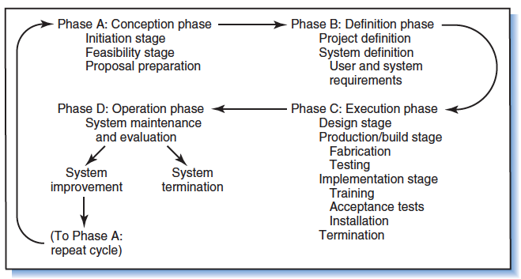
Project

Slide 5
Project
Phase A: Conception Phase:
Initiation:
Concept or idea ( very vague): Typically a problem faced by someone in completing something.
Generally described by a lay-man in English
Feasibility:
Technical Feasibility
Operational Feasibility
Economic Feasibility
Legal Feasibility
Schedule Feasibility
Proposal Preparation:
Solution developed by the same person who is having some difficulties
Ask solution from some experts
Investor/ Sponsor
Solution Providing Organization
Client/ End User

Slide 6
Project
Phase B: Definition Phase:
Project Definition:
Prepare a reference document to be used by solution providing organization or by sponsor to understand WHAT kind of issues are faced
System Definition:
Details of what exactly the solution should provide
User and System Requirements:
Facilities to be provided in the system/ solution required

Slide 7
Project
Phase C: Execution Phase:
Design Phase:
Concept or idea ( very vague): Typically a problem faced by someone in completing something.
Generally described by a lay-man in English
Production/ Build Stage:
Coding
Fabrication
Testing
Implementation Stage (Commissioning):
Training
Acceptance Test
Installation
Termination

Slide 8
Project
Phase D: Operation Phase:
System maintenance and evaluation:
System Improvement
System Termination

Slide 9
Project
Problem Definition:
Clearly mention requirements
Requirement gathering mechanism:
Surveys and questionnaire
Interviews
Market Analysis
Competitors
Solution Design:
Plan to provide successful product covering all requirements (SCOPE) in specified TIME, and in agreed upon COST
Parallel implementation of various module

Slide 10
Project
Problem Implementation:
Code
Implementation of Design
Testing:
Acceptance testing
Modules testing
System testing
Improvements

